Slide 1
Forest Protection
Abiotic factors

Slide 2
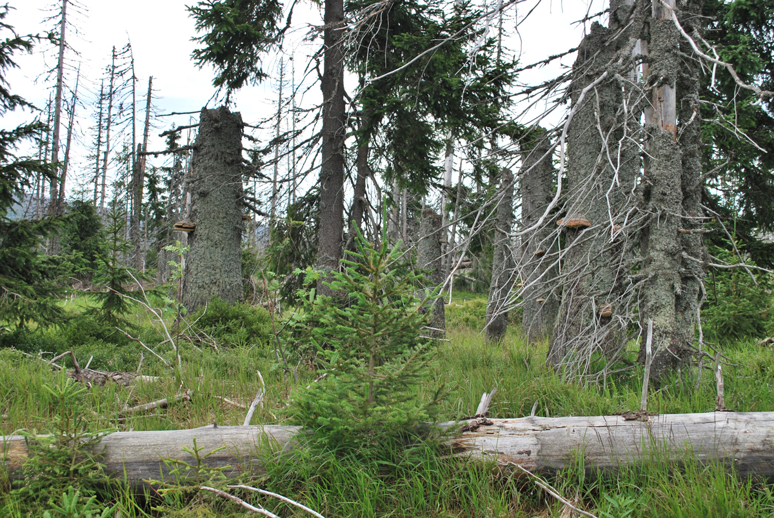
Abiotic disturbance factors
the most important disturbance factors in managed forest
can be categorized according the mode of their actions:
agents of mechanical nature – wind, snow, icing, avalanche, hailstorm effects
agents of physical nature – lightning, fire
agents of physiological nature – moisture deficiency like drought and dry spell, moisture, affluence, low temperatures, frosts of all kind (late and early frost, hard frost), high temperatures, deficiency and affluence of some nutrients and chemical element and compounds etc.
Others (volcanic activity, earthquakes, landslides, salty winds etc.)
impossible to influence directly and only prevention (through tree composition, horizontal and vertical structure of stands) can be done to minimize their unfavorable effects
Notes:
Nemáme skoro nic

Slide 3
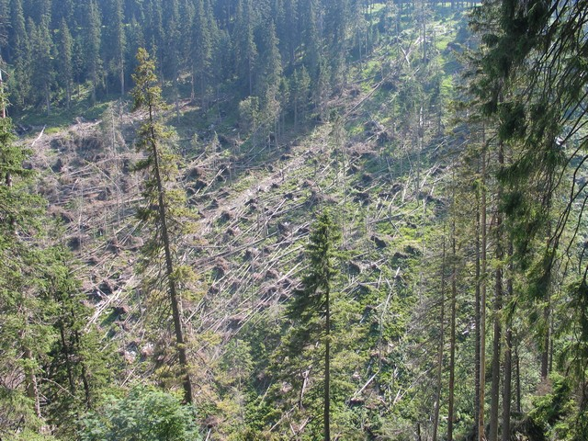
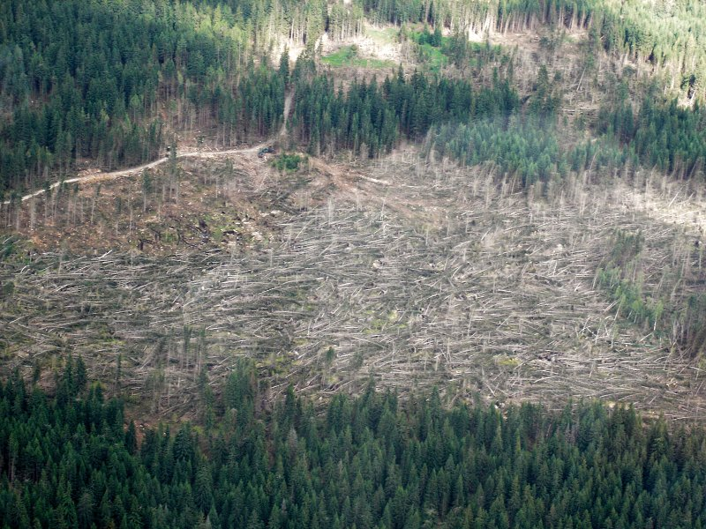
Abiotic agents - WIND
the most important disturbance agent in Central Europe
The air moves at turbulent flow –wind makes vortices, the vortices may have both horizontal axis (= gusty wind), or vertical axis (= vortexes, spouts, tornadoes)
In the mountains occasionally there is so-called „overflow wind or bora“
The predominant direction of wind is in Czech Republic usually from west to east
The damage of trees happens usually only when the speed of wind is higher than 17 m/s, wind storms with speeds exceeding 40 m/s destroyes everything
uprooting, breakage, bending of trees (stem, crown)

Slide 4
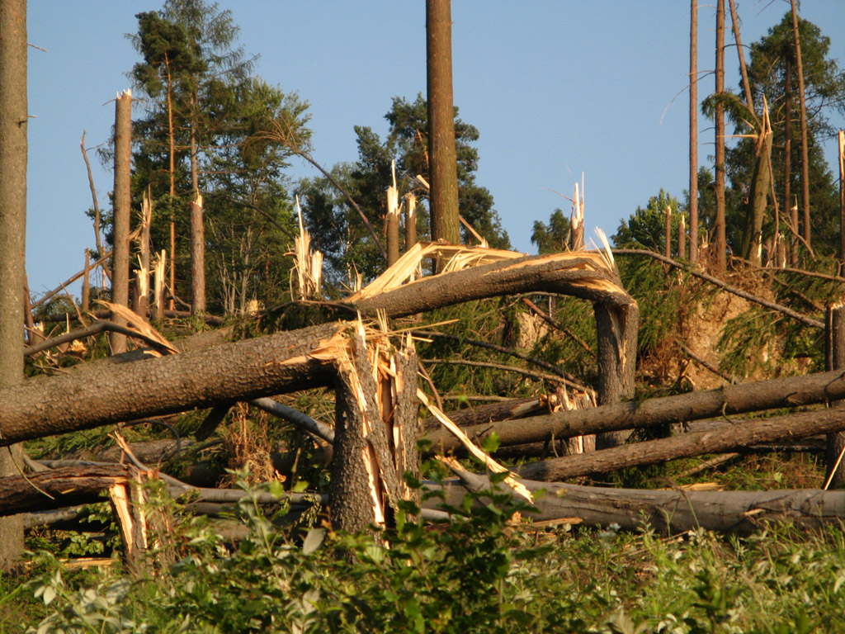
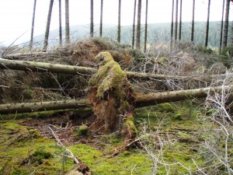

Slide 5
Abiotic agents - WIND
most damage situated in the altitudes from 400 to 800 m above sea level
older forests are in greater danger than young forests (because of center of gravity is higher in tall trees, younger trees are more flexible)
Tree species:
most vulnarable: Norway spruce, birch and trembling aspen
moderately: fir and scotch pine,
resistent: beech and oaks.
the wind damage mostly take place in the autumn or in the spring (the soil is moist and the roots are not sufficiently fixed in it)
The losses are both direct (the trunks are broken, the wood is partly disvalued, the increment in damaged younger stands is disrupted)
and non-direct losses (caused by secondary harmful factors – bark beetles, greater financial expense in processing damaged trunks and wood, etc.)

Slide 6
Abiotic agents – WIND
Possibilities, measures of protection
mostly preventive character
using „wind proof“ (hardy) tree species (the deep-rooting - beech, oaks, larch, fir)
Protection and preservation of forest edge
The cutting process from east to west (opposite direction to predominant winds)
Using strengthening elements when planting new forest (planting belts of „windproof“ tree species)
Reduction of wild game population density

Slide 7
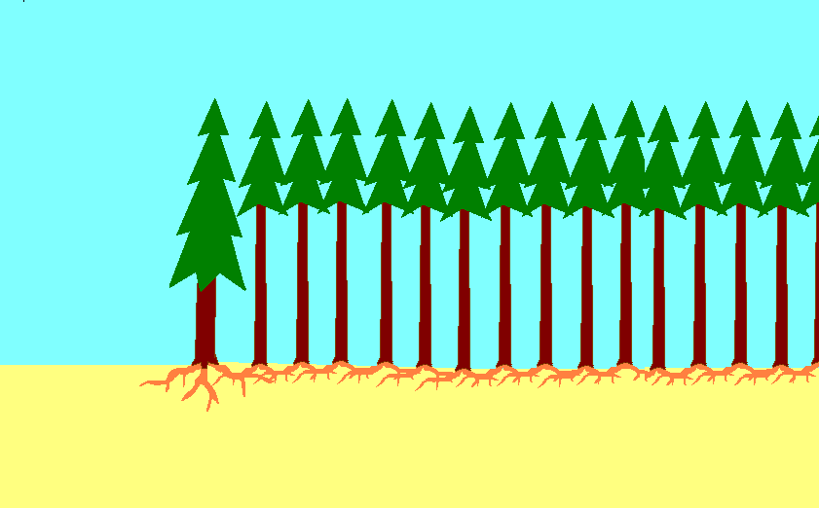
Protection and preservation of forest edge

Slide 8
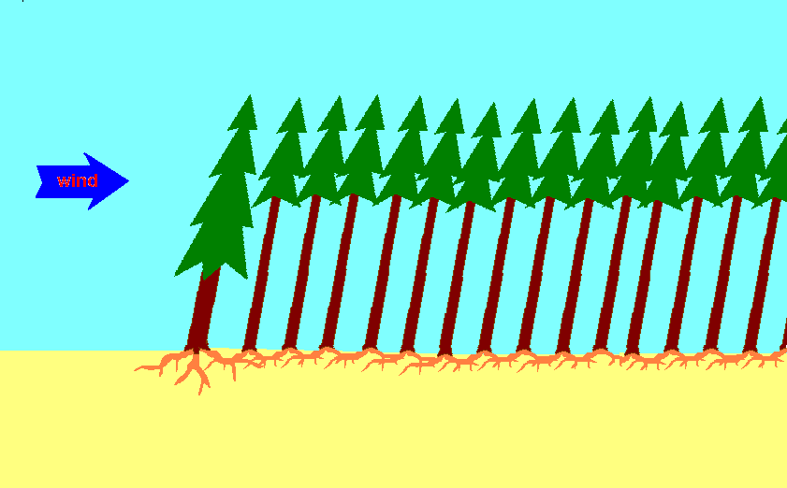
Protection and preservation of forest edge

Slide 9
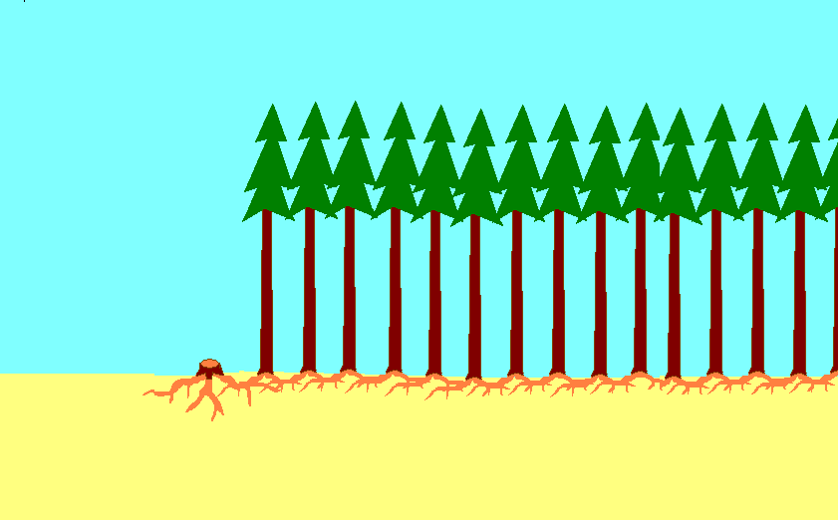
Protection and preservation of forest edge

Slide 10
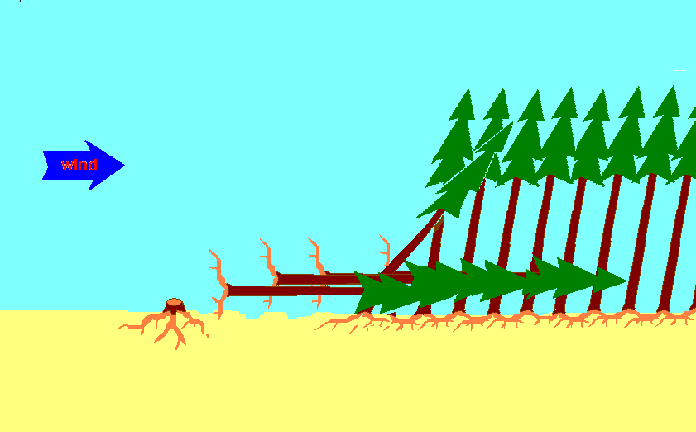
Protection and preservation of forest edge

Slide 11
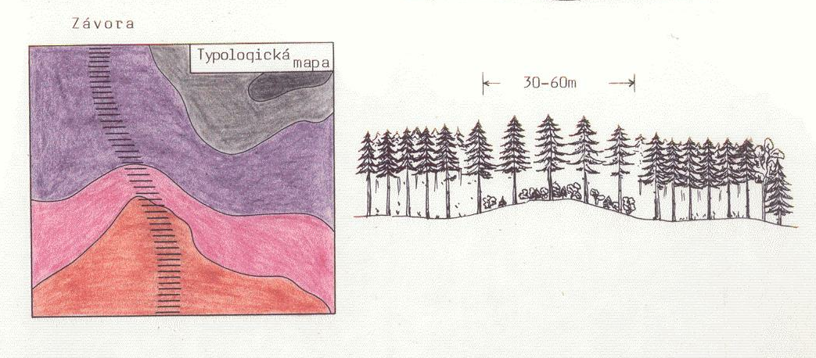
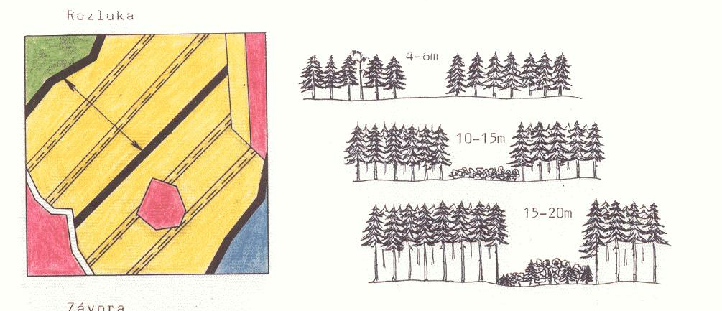
Strengthening elements

Slide 12
Abiotic agents – WATER
More than water itself, the lack of water – drought is important disturbance agent
Drougt causes:
declining of wood increment
drying of trees, esspecially young trees (the roots are shallow)
limites the fertility of forest trees (especiallly in oaks and beech stands)
activizes and favorizes secondary pests
Most harmfull is the spring drought (it is not possible succesfull reforestation in such years)

Slide 13
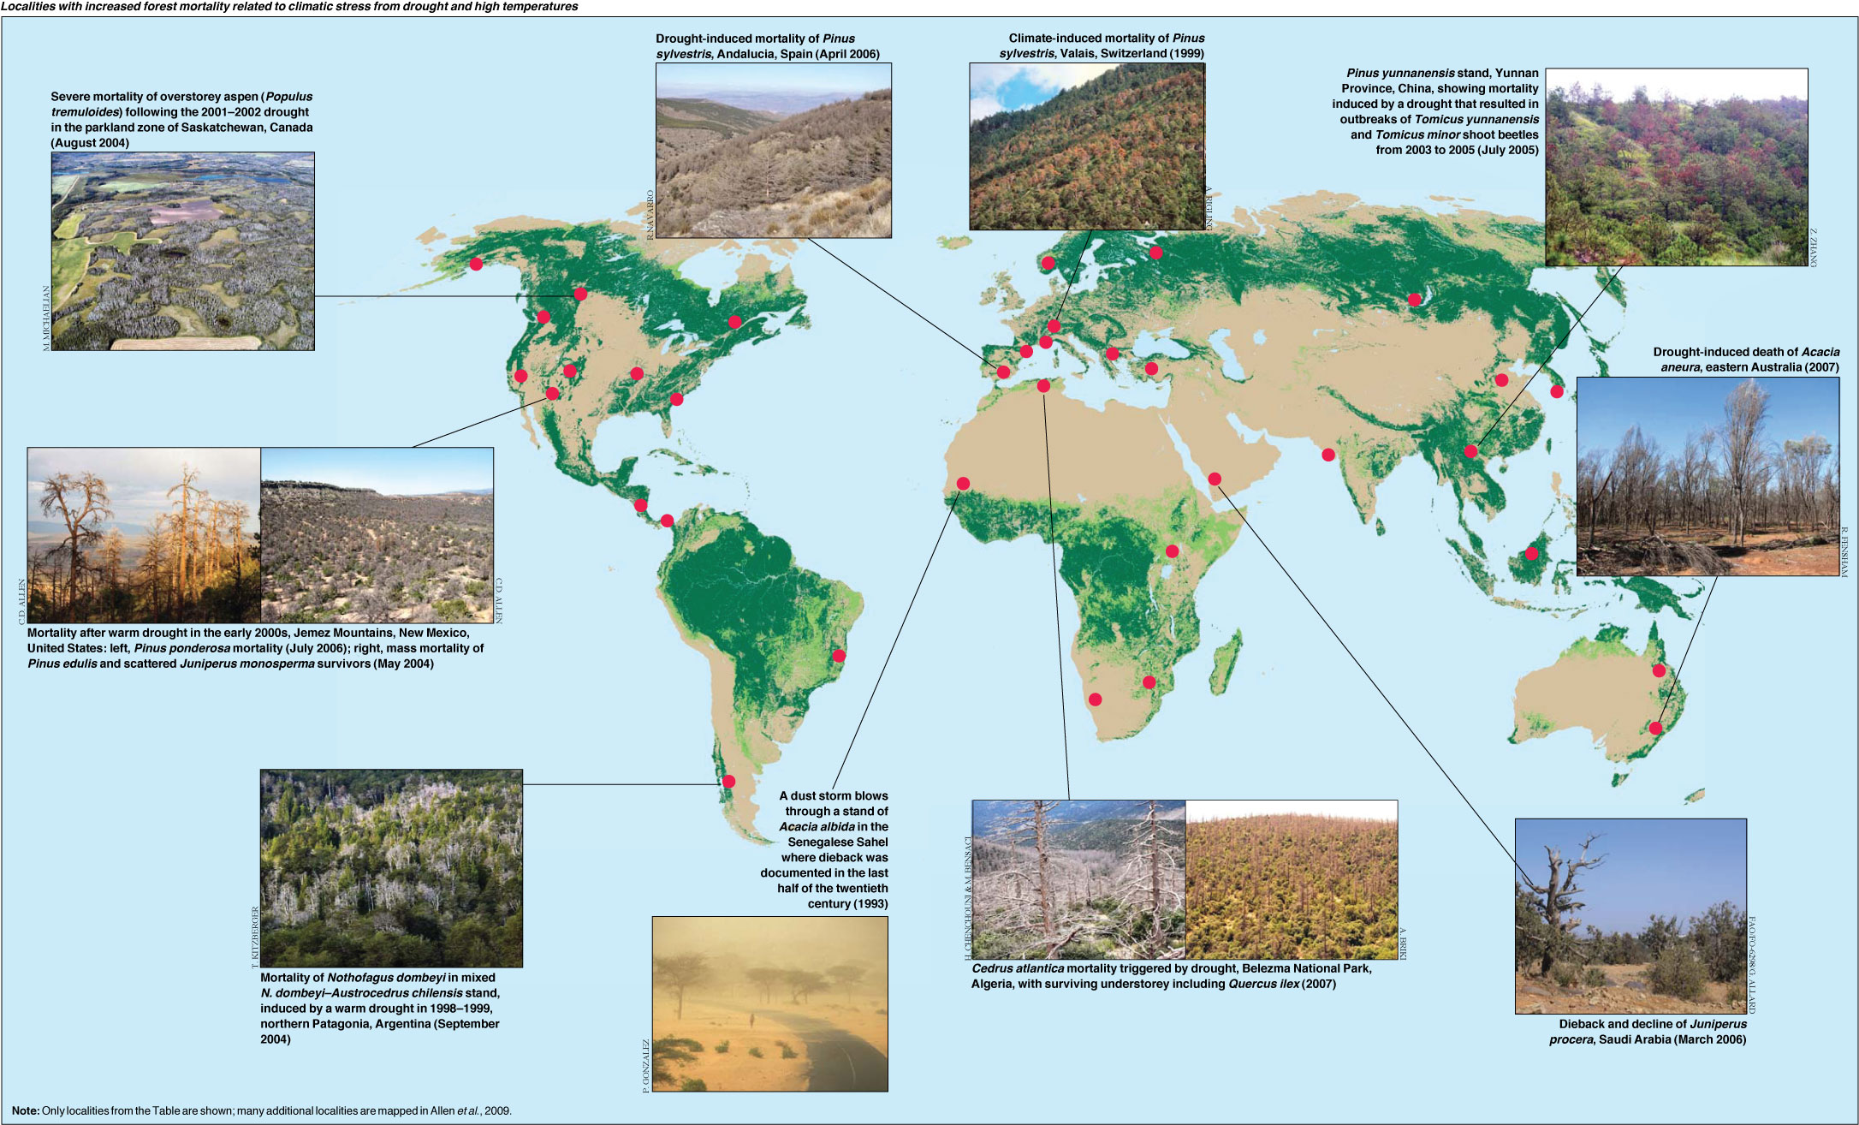

Slide 14
Abiotic agents – WATER
Possibilites of protection to drought:
The afforestation should be done early in the spring, using plants grown in containers (with coated roots), or (ussually aplicable in small scale only ) watering of plants
Use tree kinds, suitable to site and drougt tolerant (oaks, small-leaved basswood, scots pine, austrian pine)
Care of water sources, preserving small wetlands
Build forest nurseries always in the vicinity of plentifull water source

Slide 15
Abiotic agents – WATER
The excess and an overflow of water causes (floods):
Higher danger of windfall
Biggest danger in forest nurseries, esspecially in the spring (not possible to use heavy machines - for example to lift plants)
Dying of some tree species after floods
Damage of trees on riverbanks by blocks of ice (in spring floods) and by other drifted objects

Slide 16
Abiotic harmfull factors - WATER
The snow (the heavy snow)
important harmfull factor, causes great part of losses in the forests of middle elevation above sea level
the damage is caused only by so called „heavy snow“ (=wet snow) which falls usually in the spring, sometimes in the autumn
the damage take place, when the heavy snow falls at calmwind conditions (when there is no or only light wind)
most susceptible tree species to snow damage are scots pine and birch

Slide 17
Abiotic harmfull factors - WATER
The possibilities of protection to heavy snow:
selection of right ecotype of the tree species
- well timed (early and frequent) forest cleaning and juvenile thinning – the trees than have sufficient space to crown development

Slide 18
Abiotic harmfull factors - WATER
Rimefrost and glazefrost
most heavy rimefrost and glazefrost rises in the elevations of 700-800 m above sea level
rises at long-lasting cloudy weather, when the temperature is right below zero (0ºC)
damages mainly upwind walls of forest stands
damages all forest species (no tree species is resistant to rimefrost or glazefrost)

Slide 19
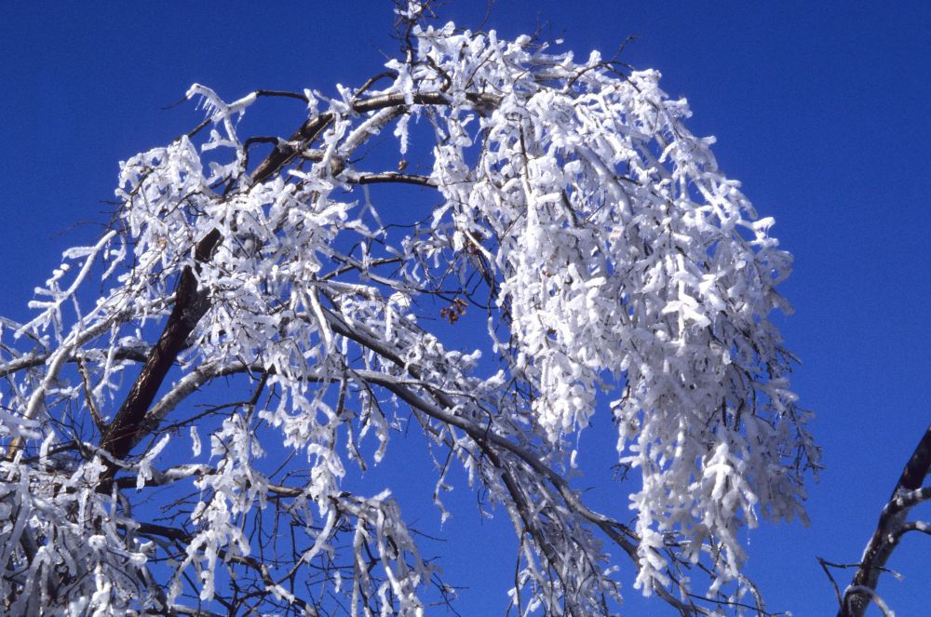

Slide 20
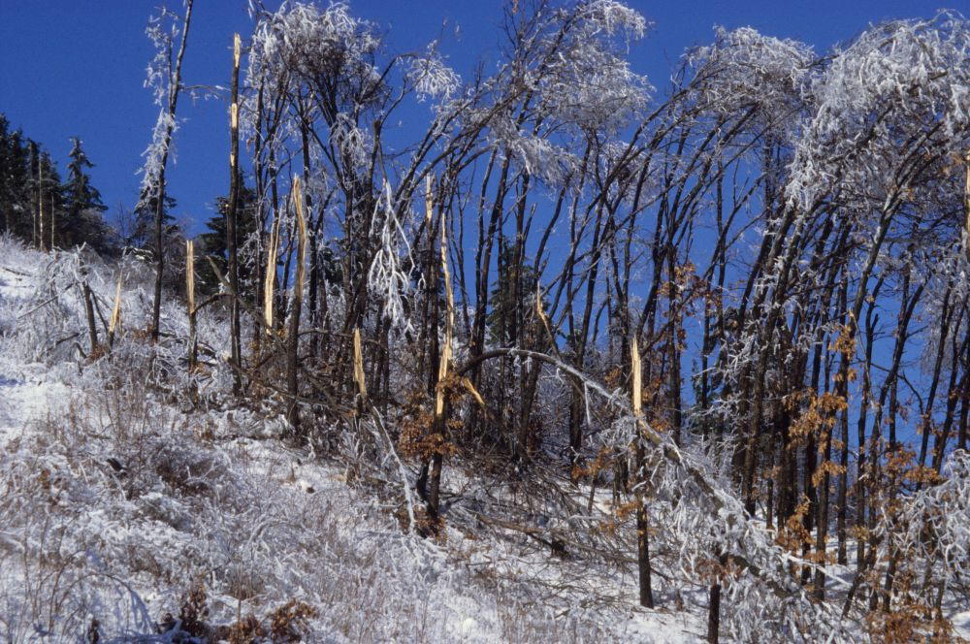

Slide 21
Abiotic harmfull factors - WATER
Avalanches
in mountain regions with steep slopes (Tatras, Alps, Alaska … and also Norway, Iceland and nothern Japan)

Slide 22
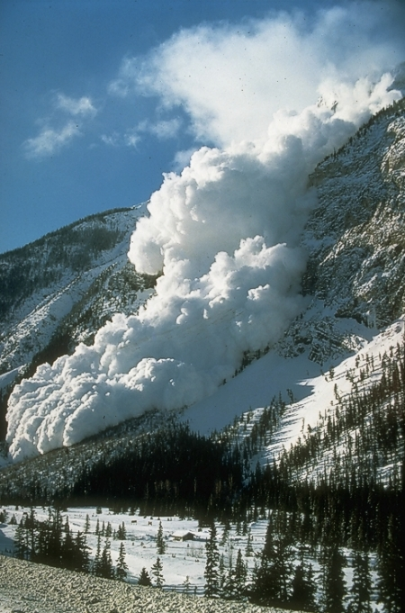
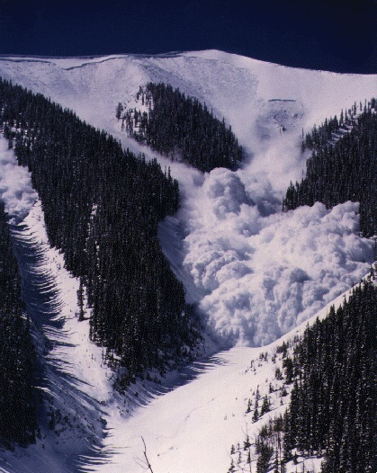

Slide 23
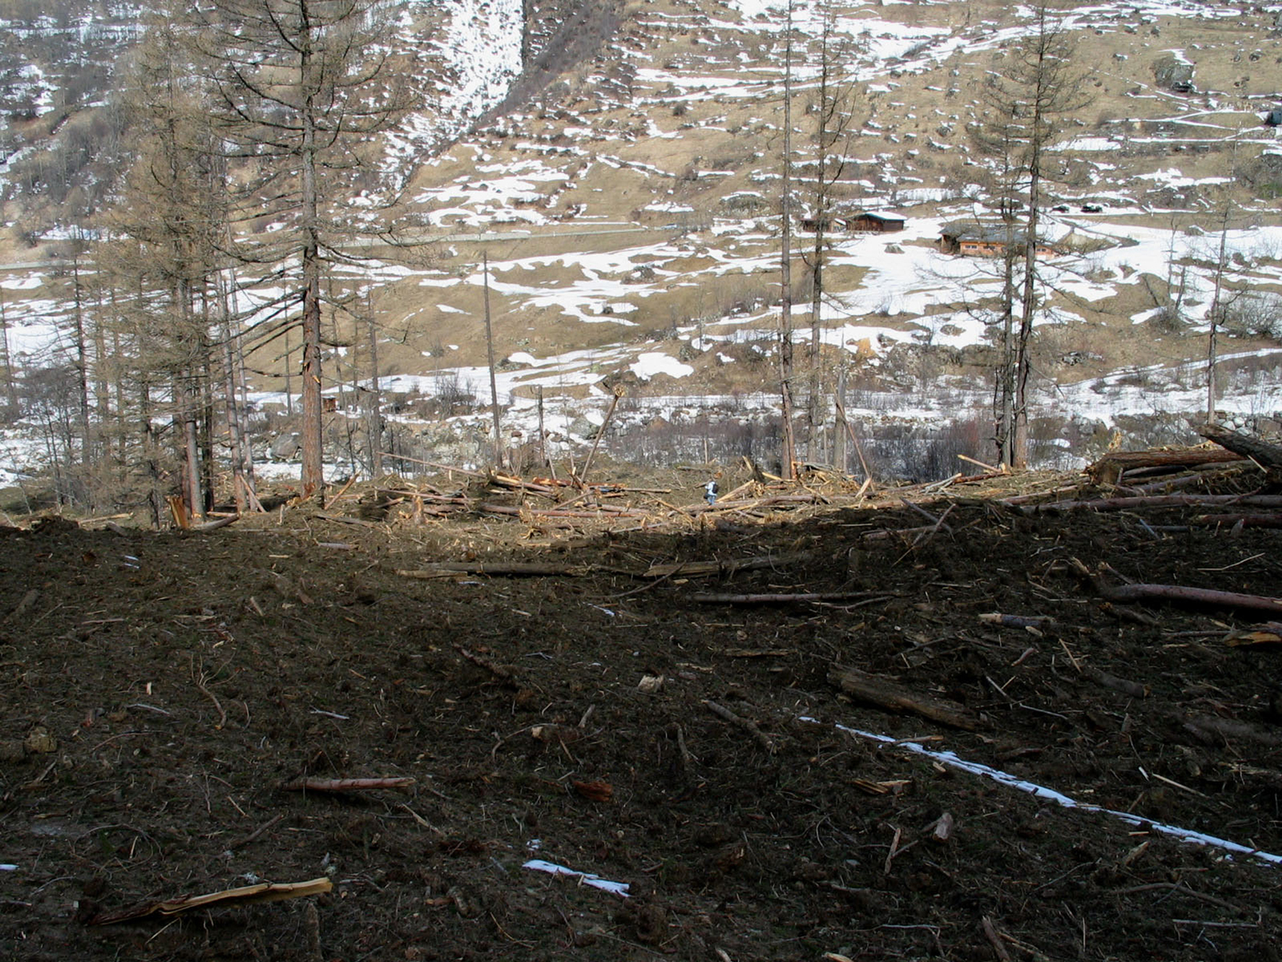
Forest damage by avalanche

Slide 24
Abiotic harmfull factors - WATER
The possibilities of protection againts avalanches:
special fences – „avalanche barriers“ up in the slopes, on the places, where the snow layers (the „snowpack“) usually is disruptig and begins slidding down
Forestation of high parts of slopes by low forest (for example with carpathian pine – Pinus mugo)
Restriction of pasture in the high parts of the steep slopes (so the young trees can grow up)
Cutting down the too much high trees in the heads of slopes (when they are broken with snow or wind, frequently they „trigger“ avalanche)
Deliberate slidding of small avalanches (still thinner layers of snow) in the high-risk areas, and where avalanches are regular

Slide 25
Avalanche fences

Slide 26
Avalanche fences

Slide 27
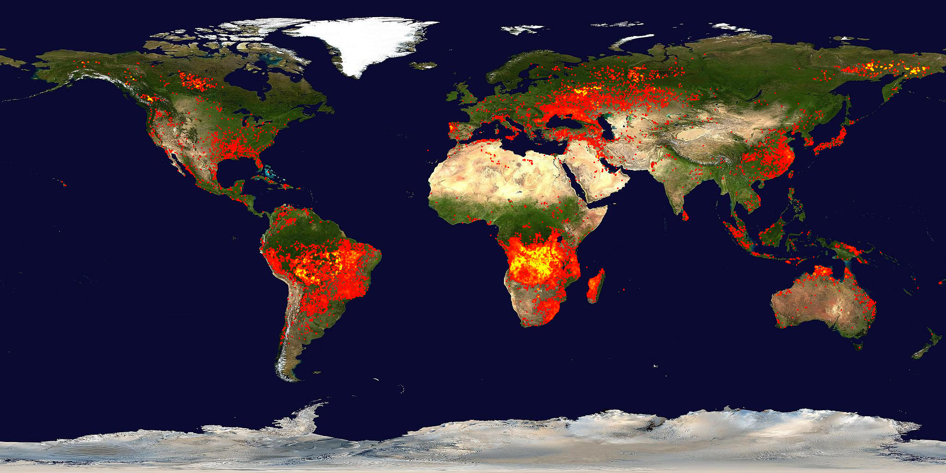
Fires

Slide 28
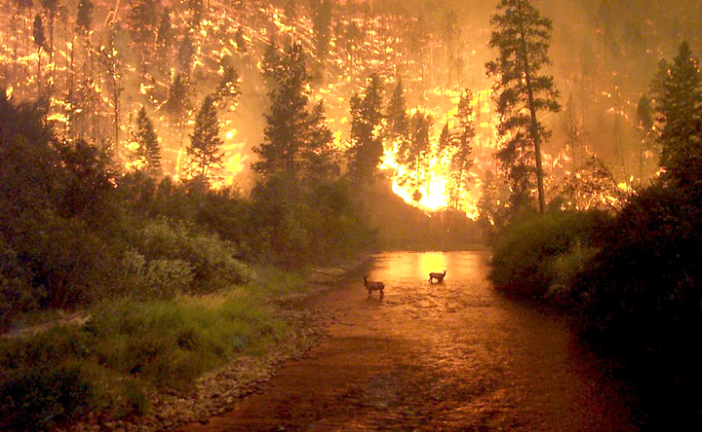

Slide 29
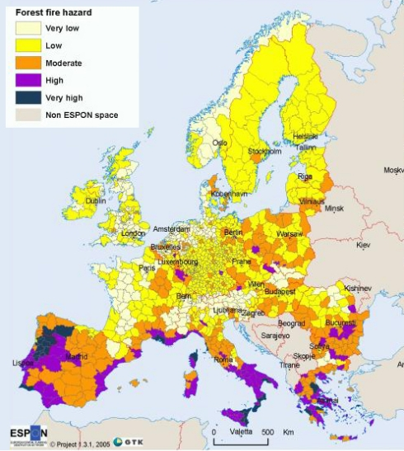
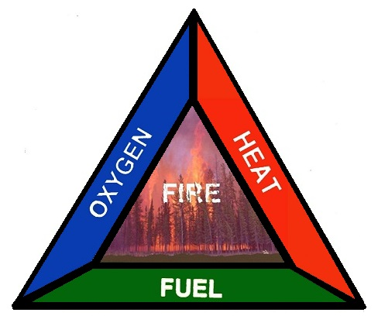
Definitions
a wildfire is any uncontrolled, non-structure fire that occurs in the wilderness, wildland, or bush
wildfires are common in various parts of the world, occurring in cycles
they are often considered beneficial to the wilderness, as many plant species are dependent on the effects of fire for growth and reproduction
however, large wildfires often have detrimental atmospheric consequences
nine out of ten wildfires are reportedly caused by some human interaction
„Fire triangle“

Slide 30
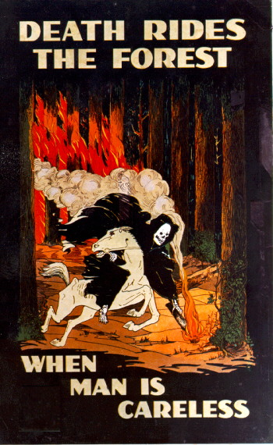
Fires
globally, an average of 400 to 500 mil. ha burn each year from forest fires
bilateral and multilateral cooperation in forest fire management has increased over the past few years.
however, cooperation on forest fire management has focused on fire suppression rather than prevention
Notes:
https://www.youtube.com/watch?v=cBnbLJ5TzvE

Slide 31
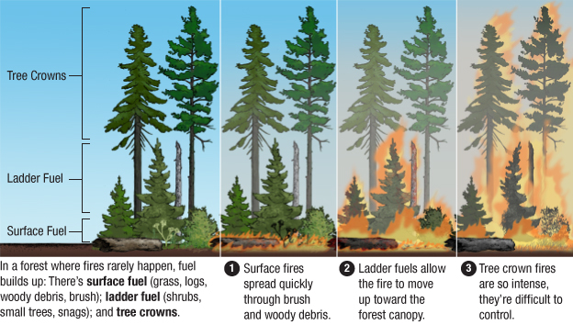
Types of forest fires

Slide 32
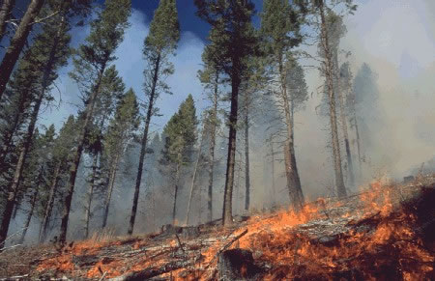
Ground Fires
Burn the organic materials beneath the surface litter of the forest floor
Fuels like peat, coal, tree roots
Common in wet, boggy areas
Smoldering fire, usually no flames
Very high heat →kills root systems

Slide 33
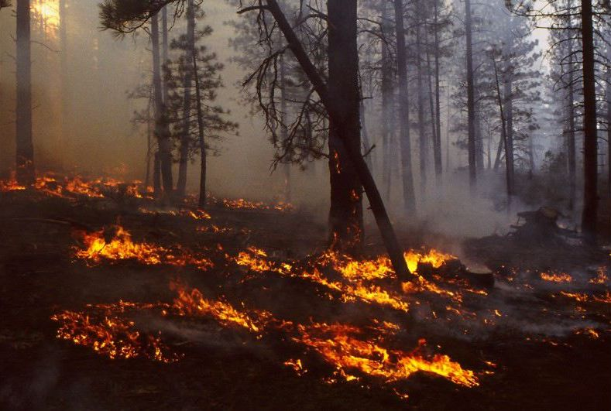
Ground fire

Slide 34
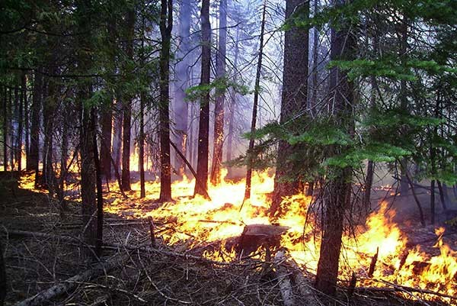
Surface Fires
Burn surface litter and small vegetation
Forest canopy is not generally burned
Most fires begin as surface fires
Easiest to control
Notes:
Surface fires burn the readily combustible materials found in a forest.

Slide 35
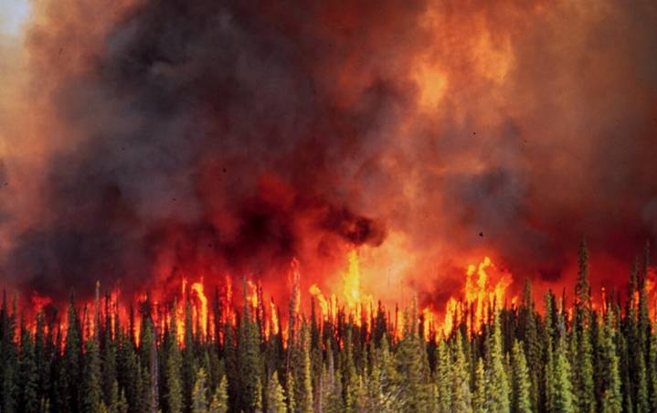
Crown Fires
Burn from top to top of trees or shrubs
Most dangerous type of fire
Can easily spread due to wind
Many conifers are highly flammable
https://www.youtube.com/watch?v=KvBRWTumoZI
Notes:
Crown fires release intense heat as it takes very high heat to combust the green portions of trees. Many conifers are highly flammable. → Why is this so? –They depend on fire to cause their seeds to germinate (break seed dormancy).

Slide 36
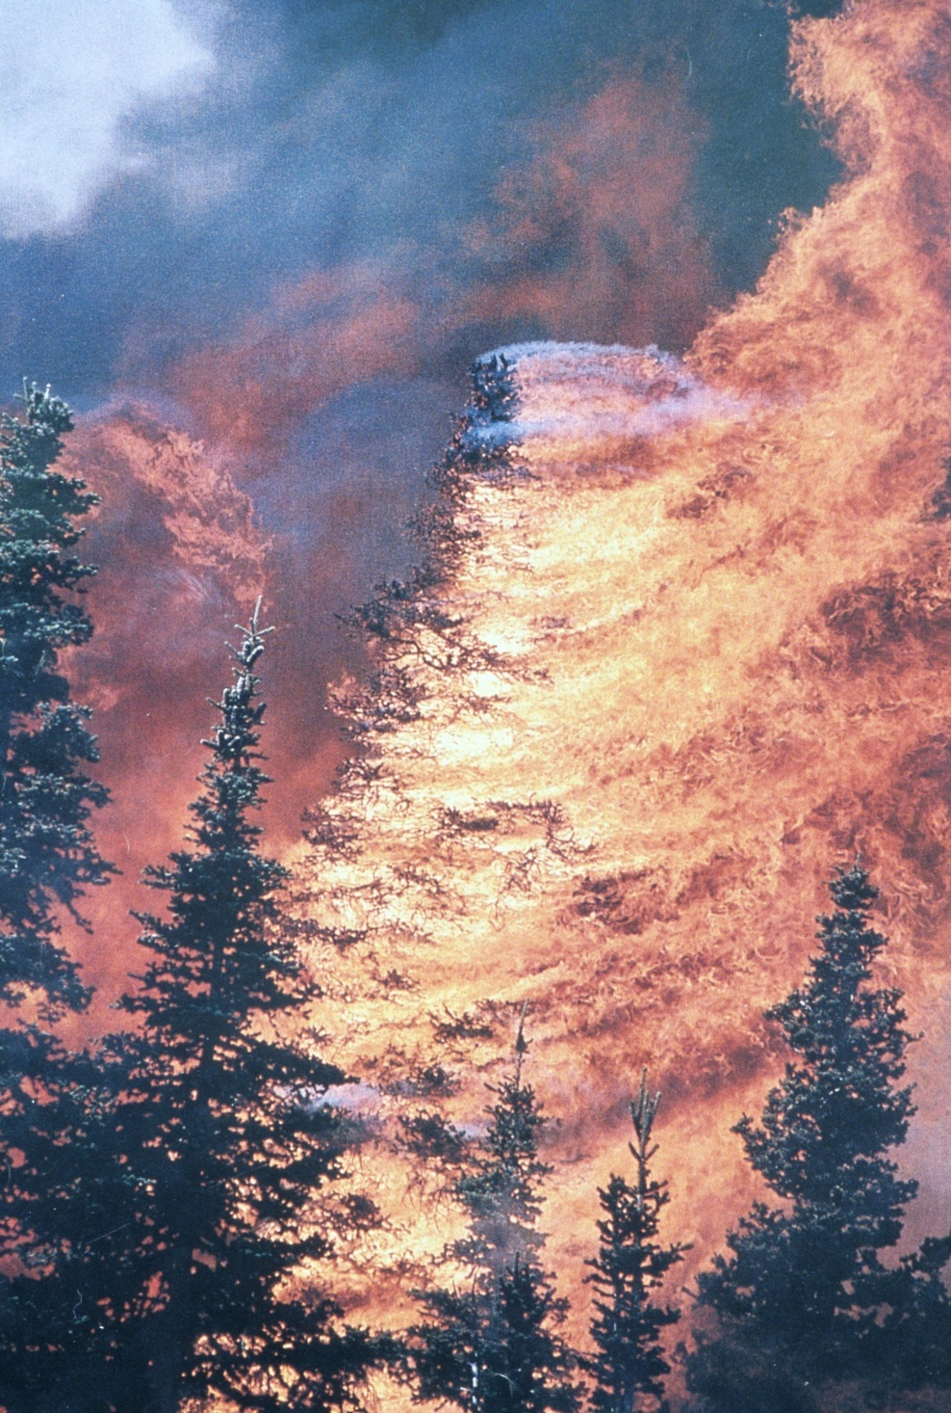
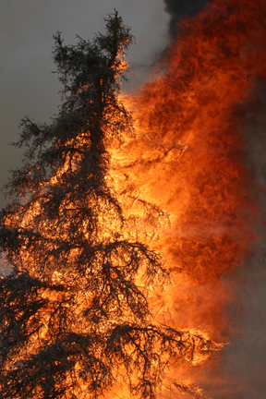
Crown fire

Slide 37
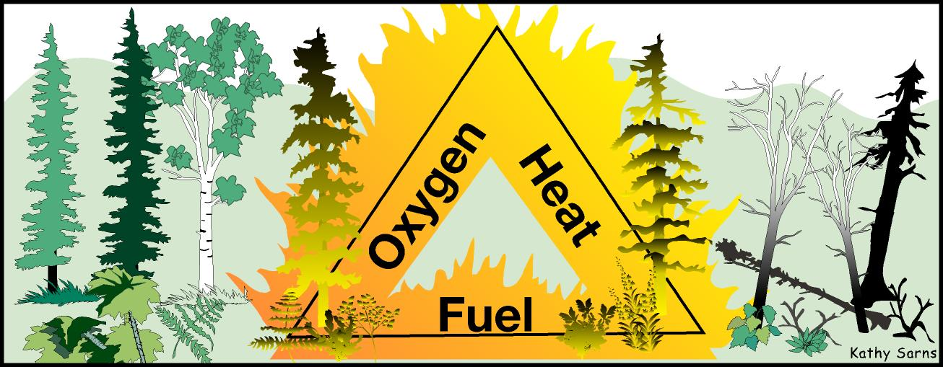
Fuel Types
Influence fire behavior
Two types
Ground fuels → peat, duff, tree roots, leaves, dead grass, weeds, low shrubs
Aerial fuels → burnable material in canopies above 6 ft from the ground

Slide 38
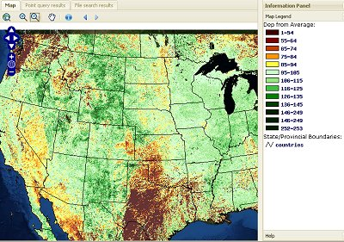
Prevention
Not continuous afforestation
Not afforestation in the vicinity of human settlement
Preventive fires of understored vegetation
Preference of broadleaved species
Educational programs
Restoring the water in the landscape
Preventive monitoring and use of GIS for risk estimation

Slide 39
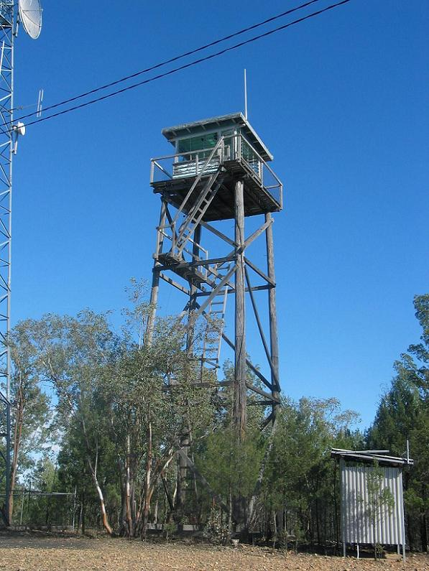
Detection
Lookout towers
An alidade → determine the azimuth of a detected fire from two lookout towers
Triangulation → 2 azimuths taken from two towers pinpoints fire location
Telephone reports from motorists
Fire-watch planes
Remote sensing equipment
Satellite imaging systems
Notes:
Azimuth = direction

Slide 40
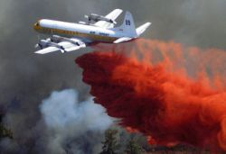
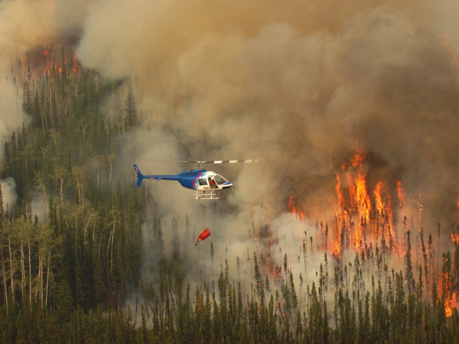
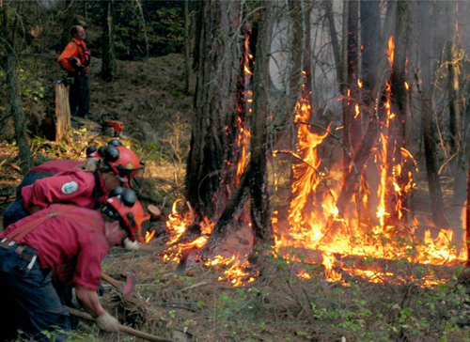
Suppression
isolation of fires – separation of forest to smaller blocks
professional firemen organizations
aerial anti-fire service (including the construction of water reservoirs)

Slide 41
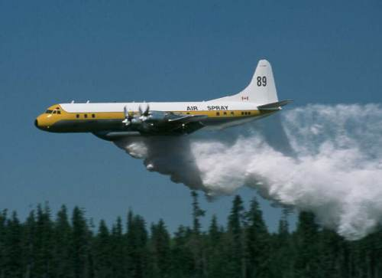
Fighting of crown fire with use of special aircrafts

Slide 42
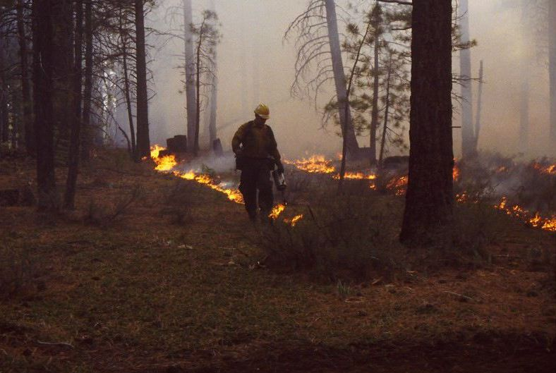
Prescribed burning

Slide 43
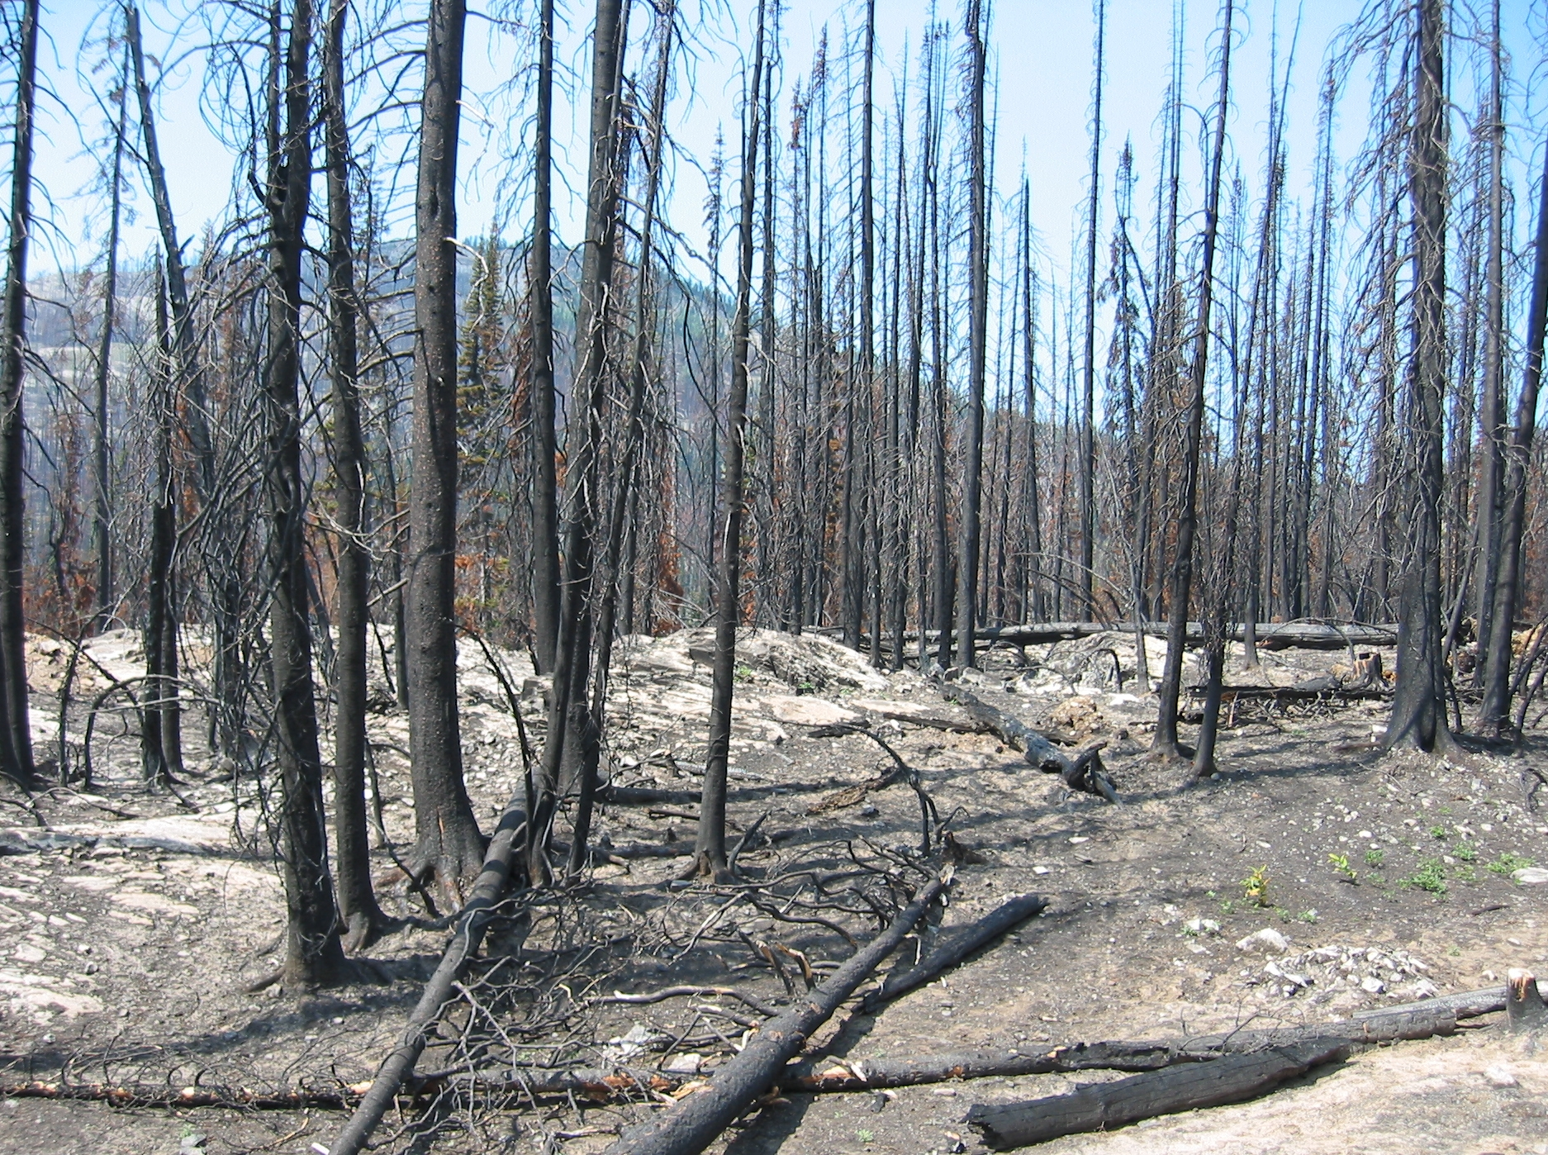
(Yellowstone National Park, 1988)

Slide 44
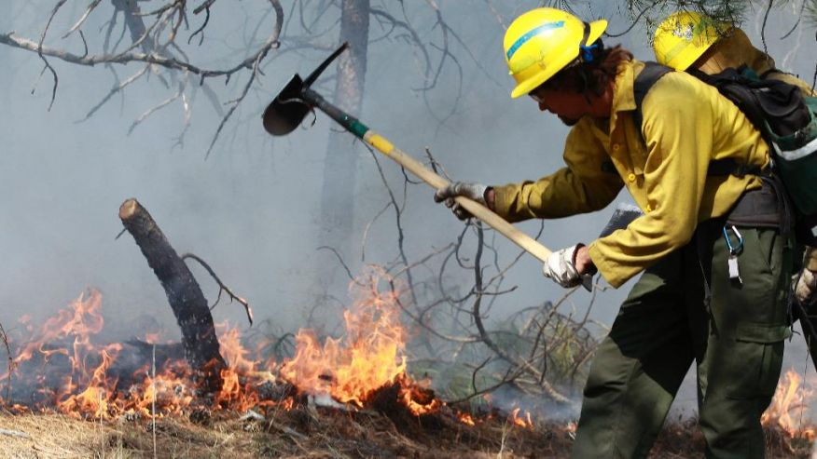
Afforestation after disaster
no afforestation in risky areas!!!
preference of tree species with low production of flammable products
spatial separation of forests blocks via anti-fire lines (which must be cleaned – by preventive fires, grazing by animals)

